Slide 1

Va a funcionar?
www.teamwins.com.ar
#teamwinsarg
Peter Sonderegger
Notes:
Slide Purpose: Title slide/introduction; setting the stage
Graphic: text on slide
Narration: When the BMC is presented properly, entrepreneurs, intrapreneurs and startups are able to more effectively capture the attention of their audience and leave a lasting impression. This allows them to successfully compete for scarce resources, whether it be competing for funding from investors and potential customers, or competing for a portion of the companies budget. (Click)

Slide 2
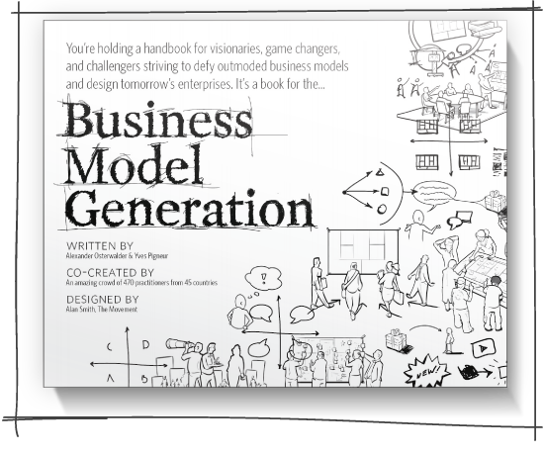

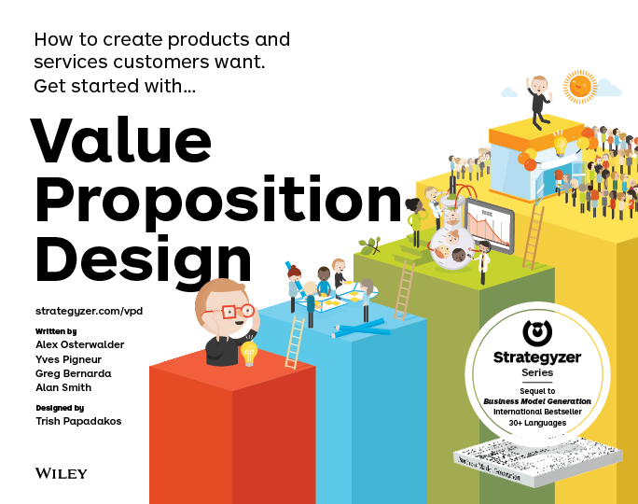
Strategyzer.com
Teamwins.com.ar

Slide 3
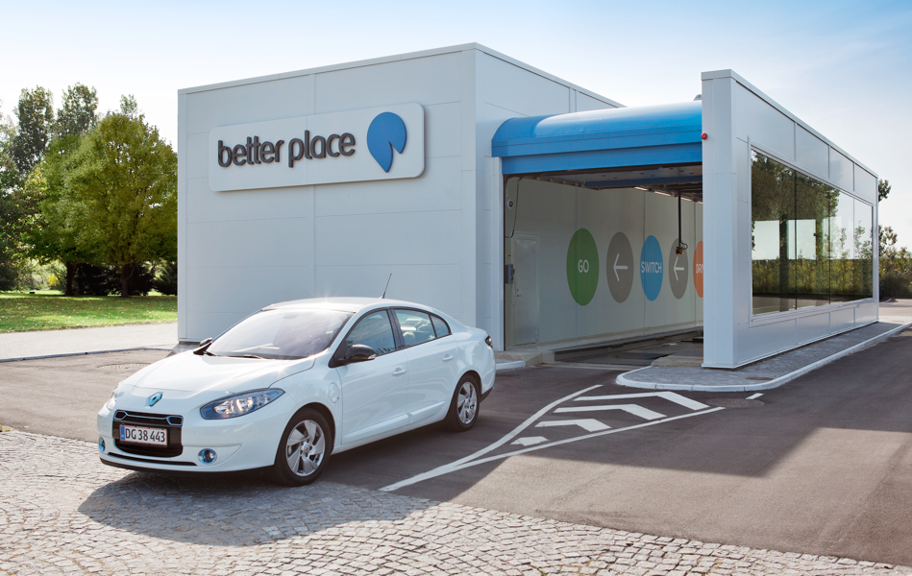

Slide 4

Cuanto $$$ gastaron ellos?

Slide 5
$850m

Slide 6
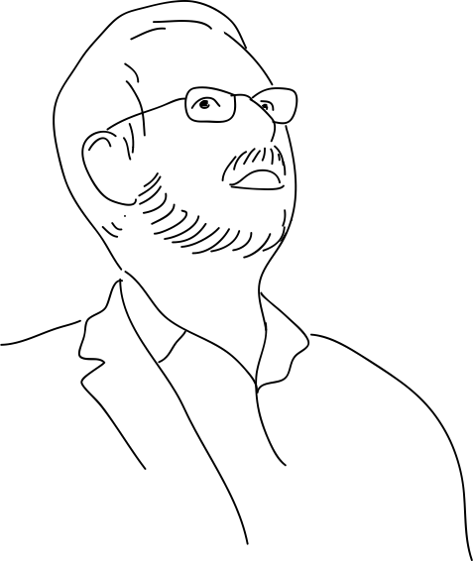


“
no business plan survives the first contact with customers
”
Steve Blank
entrepreneur & author

Slide 7

1
1.1 Business Model Canvas

Slide 8
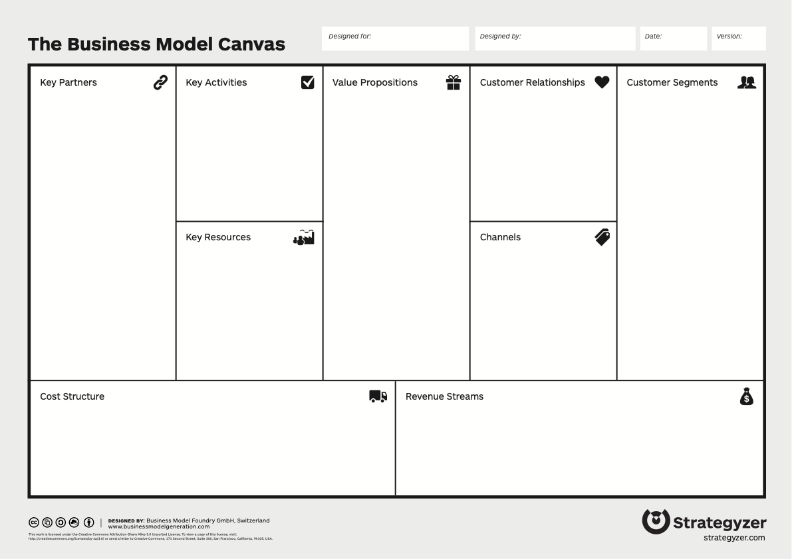
La historia visual de como usted creará valor para el cliente
Notes:
Slide Purpose: Closing the curtains
Graphic: BMC graphic
Narration: The message is clear...the Business Model Canvas is the tool to help you remain competitive in the 21st Century.

Slide 9
Notes:
Slide Purpose: Closing the curtains
Graphic: BMC graphic
Narration: The message is clear...the Business Model Canvas is the tool to help you remain competitive in the 21st Century.

Slide 10
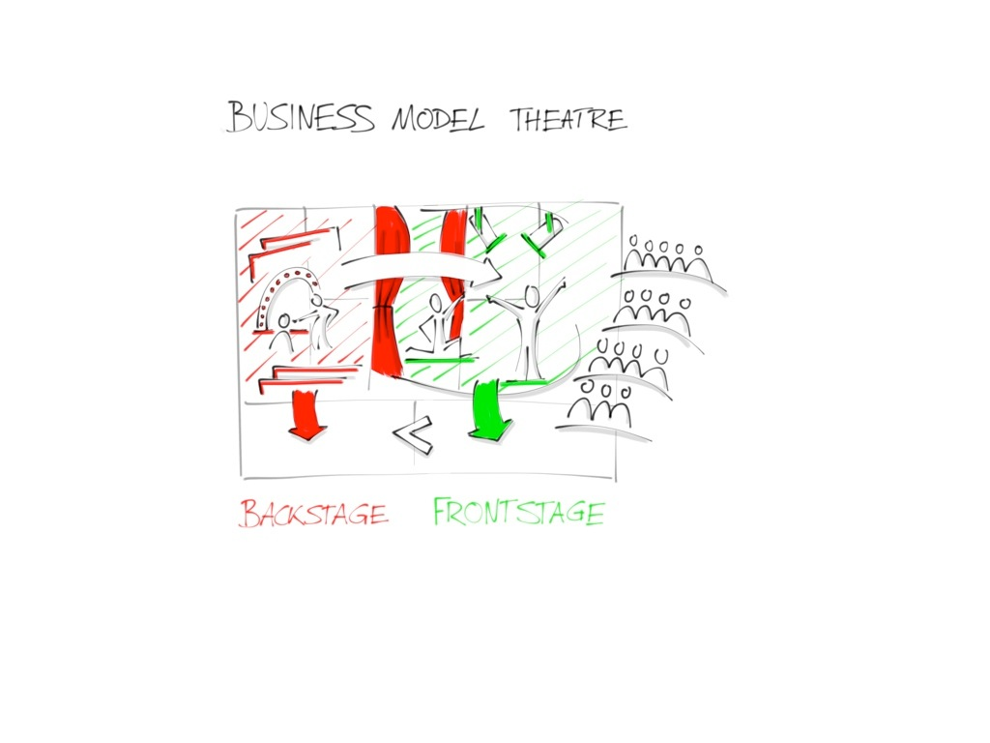
Notes:
Slide Purpose: Closing the curtains
Graphic: BMC graphic
Narration: The message is clear...the Business Model Canvas is the tool to help you remain competitive in the 21st Century.

Slide 11
Notes:
Slide Purpose: Closing the curtains
Graphic: BMC graphic
Narration: The message is clear...the Business Model Canvas is the tool to help you remain competitive in the 21st Century.

Slide 12
Notes:
Slide Purpose: Closing the curtains
Graphic: BMC graphic
Narration: The message is clear...the Business Model Canvas is the tool to help you remain competitive in the 21st Century.

Slide 13
Notes:
Slide Purpose: Closing the curtains
Graphic: BMC graphic
Narration: The message is clear...the Business Model Canvas is the tool to help you remain competitive in the 21st Century.

Slide 14
Notes:
Slide Purpose: Closing the curtains
Graphic: BMC graphic
Narration: The message is clear...the Business Model Canvas is the tool to help you remain competitive in the 21st Century.

Slide 15

¿Por qué fracasan las empresas ?

Slide 16
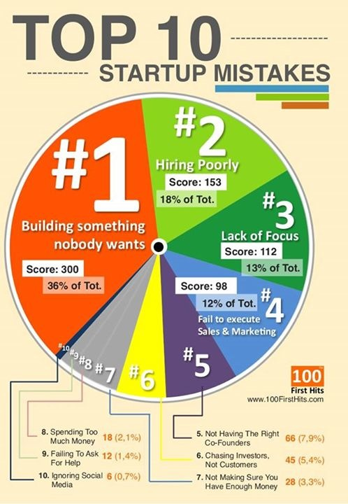
http://media.100firsthits.com/2013/11/Startup-Mistakes-Infographics.png
2014

Slide 17
Ejercicio
Explica los problemos del tourista etrangera.

Slide 18


Slide 19
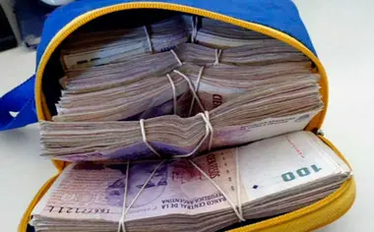
No es seguridad o trafico
Pagar

Slide 20

VP Canvas
New

Slide 21


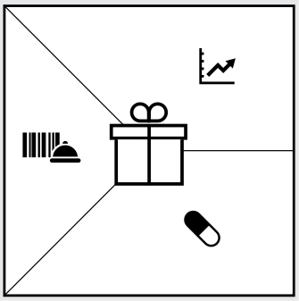

zooming en la propuesta de valor
Notes:
Slide Purpose: Closing the curtains
Graphic: BMC graphic
Narration: The message is clear...the Business Model Canvas is the tool to help you remain competitive in the 21st Century.

Slide 22
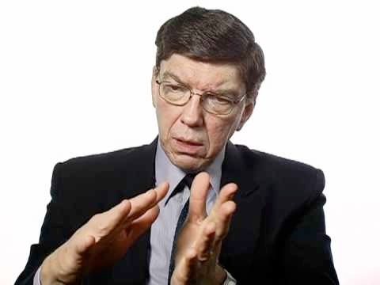
“
Jobs-to-be-done offers a clear way to innovate
”
– Clay Christensen, HBS

Slide 23

“
The focus should be on what jobs customers are trying to get done.
”
– Tony Ulwick, Founder Strategyn
Notes:
http://strategyn.com/wp-content/uploads/2012/11/tony_ulwick.jpg

Slide 24
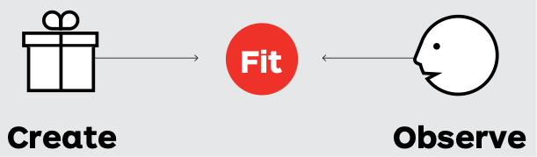
value map
customer profile
cuenta la manera en como usted crea valor para el cliente

Slide 25
1.2
1.2.1 Perfil de cliente
1.2.2 Mapa de valor
1.2.3 Fit

Slide 26
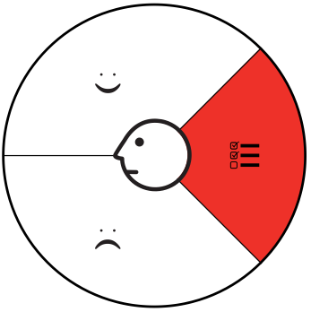
Trabajos a realizar por el cliente
  Qué es lo que el cliente desea resolver en su vida o su trabajo diario?
  TAREA, la resolución de inquietudes o problemas

Slide 27

Los dolores del cliente
Aspectos negativos, miedos, riesgos y barreras conectado a los trabajos que el cliente desea resolver

Slide 28

Beneficios/alegrías del cliente
Describir los beneficios o alegrías esperados por los cliente.

Slide 29

Perfil de cliente
Notes:
The decision attitude towards problem solving assumes that it is easy to come up with alternatives to consider but difficult to choose between them

Slide 30
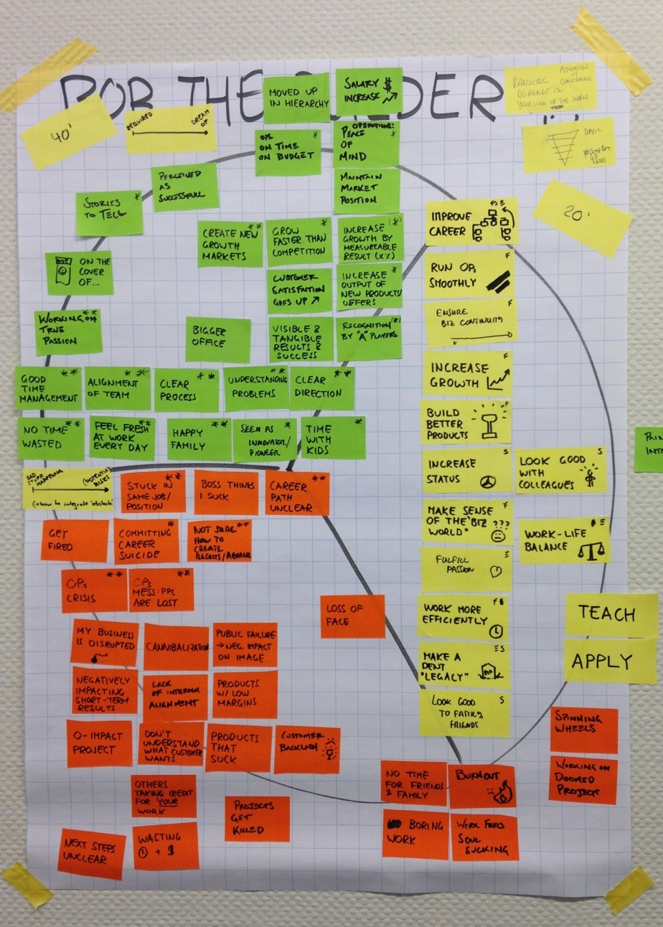

Slide 31
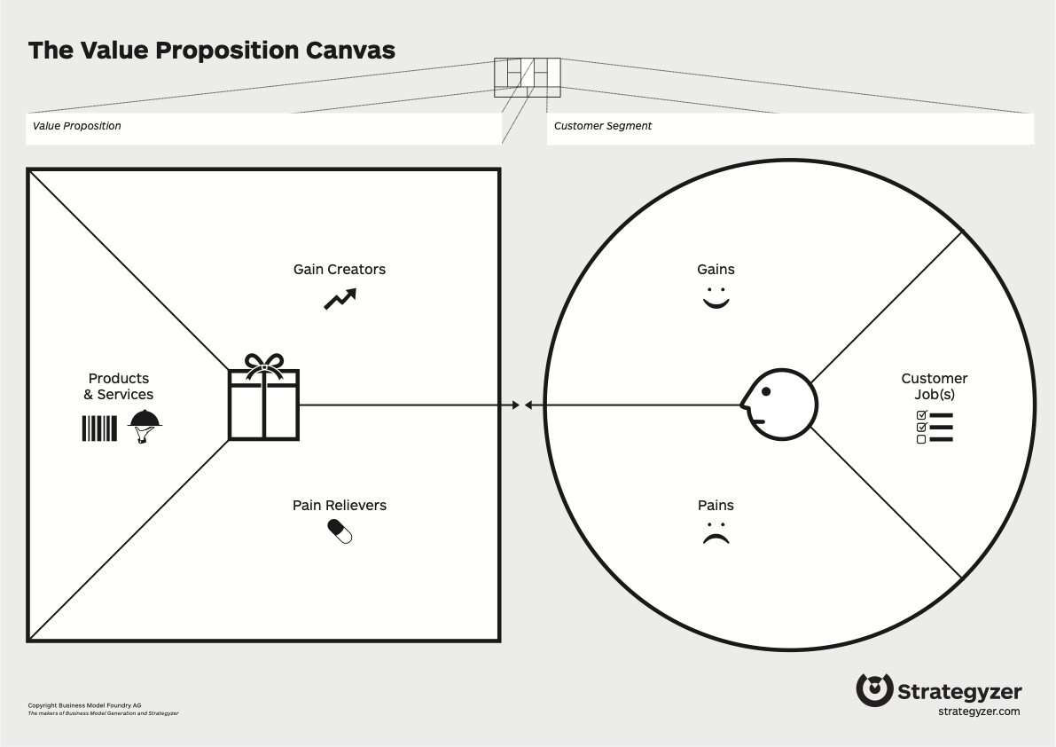

Slide 32
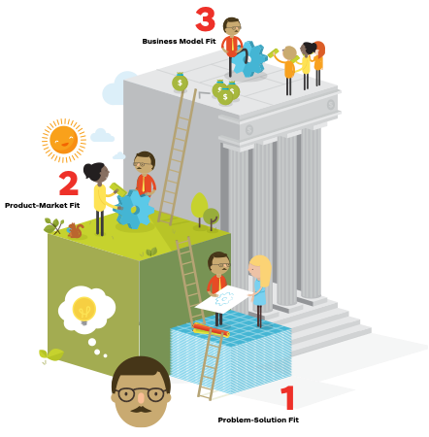
Three kinds of fit

Slide 33
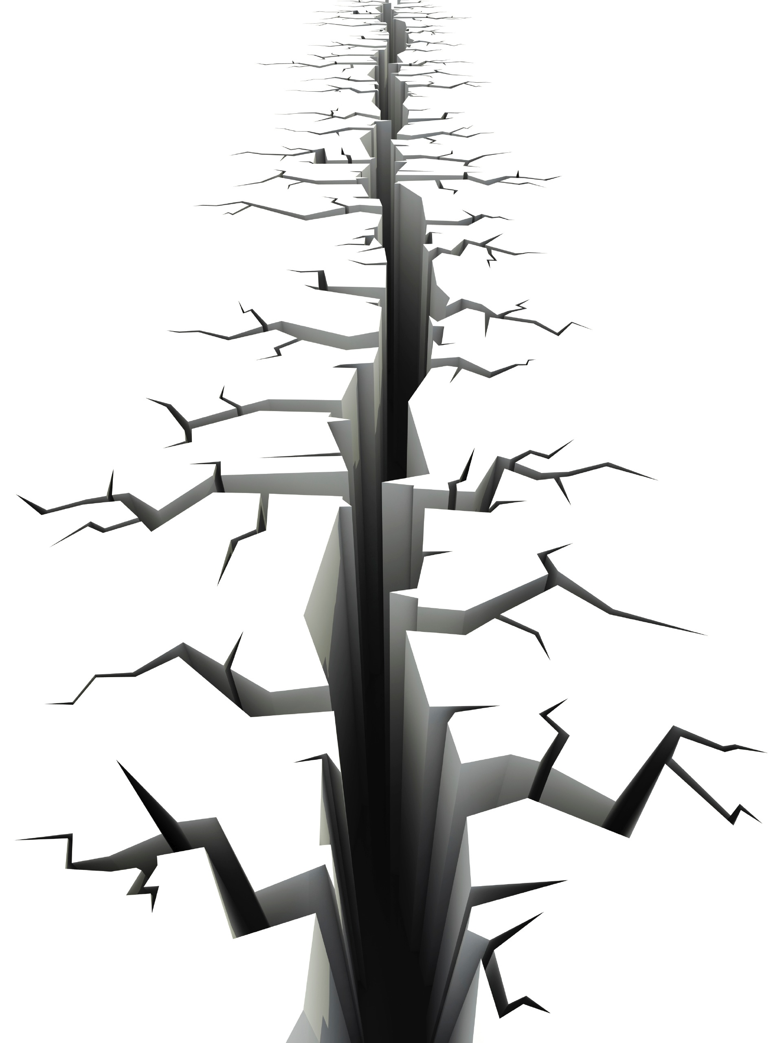

Slide 34
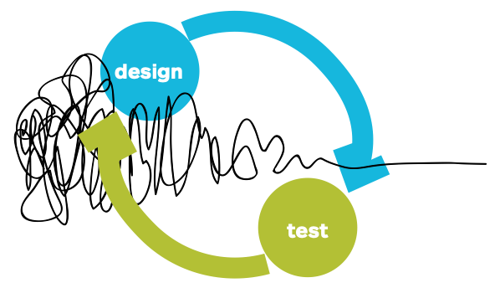


Slide 35

prueba

Slide 36
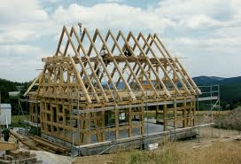
Crear prototipos

Slide 37

def.
prototyping
(pro·to·typ·ing)
* el proceso de hacer modelos rápidos, baratos y a grandes rasgos
aprender y descubrir ventajas, posibilidad y factibilidad de soluciones
Notes:
We see prototypes representing potential
future business models: as tools that serve the purpose of discussion,
inquiry, or proof of concept. A business model prototype can
take the form of a simple sketch, a fully thought-through concept
described with the Business Model Canvas, or a spreadsheet that
simulates the financial workings of a new business.
They are used to help us know and understand the subject matter they represent.

Slide 38

Feedback

Slide 39
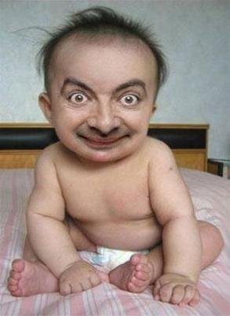
Tu bebé es feo!!!!!
Gib einen Untertitel durch Tippen ein.
Notes:
We see prototypes representing potential
future business models: as tools that serve the purpose of discussion,
inquiry, or proof of concept. A business model prototype can
take the form of a simple sketch, a fully thought-through concept
described with the Business Model Canvas, or a spreadsheet that
simulates the financial workings of a new business.
They are used to help us know and understand the subject matter they represent.

Slide 40
Reglas de feedback
Escucha
No respondas
No te defiendas
Toma nota
La critica tiene el más valor
Notes:
this business model testing process is called Customer Development

Slide 41

Notes:
scrunch up paper ball

Slide 42
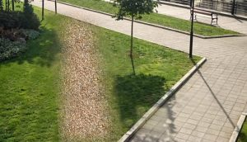

Slide 43


Slide 44
teamwins.com.ar
Peter@teamwins.com.ar
Notes:
Slide Purpose: Title slide/introduction; setting the stage
Graphic: text on slide
Narration: When the BMC is presented properly, entrepreneurs, intrapreneurs and startups are able to more effectively capture the attention of their audience and leave a lasting impression. This allows them to successfully compete for scarce resources, whether it be competing for funding from investors and potential customers, or competing for a portion of the companies budget. (Click)

